Slide 1
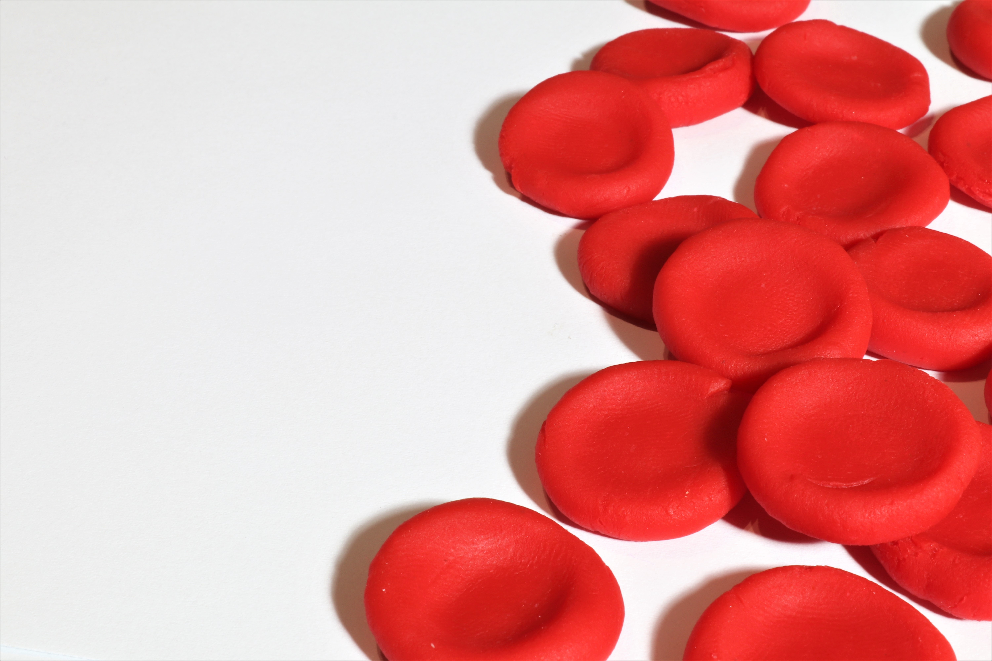
Finding structure within Cell-Dyn
Utrecht Patient Oriented Database (UPOD)
Using clustering techniques

Slide 2
Agenda
The dataset.
The goal of the project.
What has currently been done?
Preliminary results
Way forward and feedbacks

Slide 3
Dataset: Cell-Dyn blood analyser
The Cell-Dyn sapphire hematology analyser
Flow cytometry
Counting and identifying blood types
Dataset attached to UPOD

Slide 4
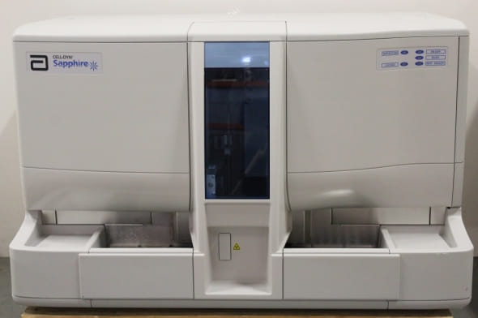
Dataset: Cell-Dyn
https://www.labmakelaar.com/
Starts from the year 2005
3,093,792 samples
358,614 unique IDs for patients
Contains over 200 features

Slide 5
The goal of the project
Very large dataset without labels
Finding structure using embedding and clustering
Work had been done on embedding and clustering
        Jille van der Togt, Huibert-Jan Joosse, Dr S. van Splunter, Dr Bram van Es
        UMAP and HDBSCAN -> finding 76 clusters
Time series clustering and identifying movement of group/ patients across time

Slide 6
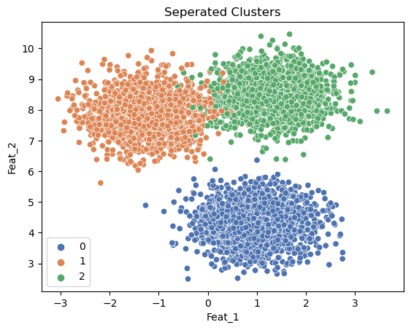
The goal of the project: Cluster hoppers!

Slide 7
What has been done?
Pre-processing : Huibert-Jan and Bram
- Selected -> c_b features -> 81 altogether
- Log transform wbc, neu, bas
- Transform distributions to normal when possible to deal with outliners
- Used miceforrest to impute NAs

Slide 8
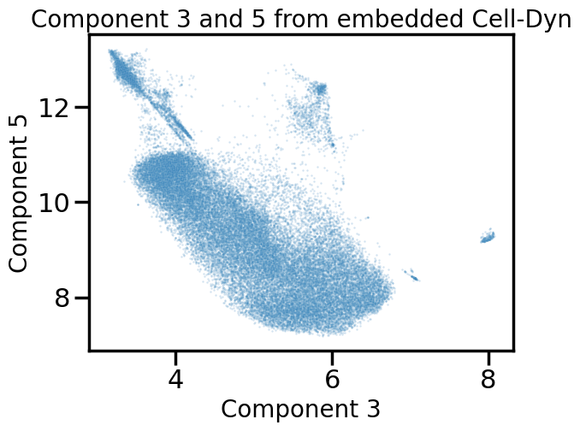
What has been done?
Embedding
        Bram and Huibert-Jan
        UMAP!
        Reduced to 6 dimension

Slide 9
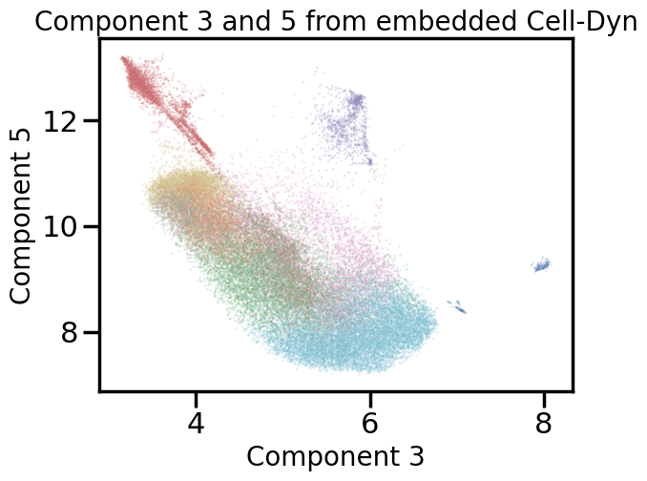
What is currently happening?
My task
Testing various clustering algorithms with their parameter sets
        HDBSCAN
        Gaussian Mixture model
Grid search and Random search for parameters depending on the situation
Evaluators
      Silhouette score
      Davies-Bouldin index
      Dun index
Gaussian Mixture model: 11 clusters and silhouette score of 0.318085

Slide 10
Evaluators
‘Qualitative’ measures of cluster fitness
Based on how separated each cluster are from one another and how close the points within the same cluster are.
Separated clusters and the points within the same cluster are dense -> good clustering.
Silhouette score -> range from -1 to 1 -> higher is better
Davies-Bouldin index -> generally range between 0 to 2 -> lower is better
Dunn index -> range from 0 to 1 -> higher is better

Slide 11
Preliminary results
HDBSCAN
        Originally found only 3 clusters with 20,000 samples (3 clusters even with full data)
          Silhouette score -> 0.551161
          Davies-Bouldin index -> 0.34198
          Dunn index -> 0.625911
        Found 24 clusters currently with newly processed data
          Have not yet evaluate the new results
Gaussian mixture model (GMM)
      First used dynamic tree cut to choose number of clusters on 20,000 samples
      Found 11
      Feed the number to GMM with 20,000 samples
          Silhouette score -> 0.334337
          Davies-Bouldin index -> 0.945764
          Dunn index -> 0.00852369

Slide 12
Way forward and feedbacks
New data set trained on HDBSCAN looks promising.
Looking for clustering algorithm suggestions.
Looking for new evaluation methods that are faster than Silhouette score which also takes noise into account (any suggestions again).
Once stable clustering is found -> starting on time series clustering.

